Slide 1
Biodiversity in National Parks
Analyse Data with Python
Jacob Collins
13th November 2021

Slide 2
Table of Contents
1. Analysis Overview
2. Species data used in the analysis
3. Analysis on Species data
4. Recommendations about Endangered Species

Slide 3
1. Analysis Overview

Slide 4
1.1 Overview of Analysis
This project utilised Python and Jupyter Notebooks to analyse, clean up and plot data and pose questions on endangered species in several different US national parks.
As part of this project, one dataset was used to carry out the analysis:
“species_info.csv”
An additional dataset had been provided to carry out analysis on sheep populations in US national parks. This analysis isn’t included in this presentation.

Slide 5
1.2 Dataset Overview
This project used and analysed data from one core DataFrame:
“species_info”: This DataFrame contains series regarding the species information, such as category, scientific name, and the conservation status.
Data has been cleaned and inspected using exploratory data analysis techniques including replacing ‘NaN’ values with meaningful values taking advantage of the Pandas module, inspecting the first 5 records of the DataFrame and identifying unique values in specific series within the DataFrame.

Slide 6
2. Species data used in the analysis

Slide 7
2.1 Overview of the data used to perform analysis
The .CSV file used to conduct analysis on biodiversity in U.S National Parks was “species_info.csv”. This contained data on different species observed in National Parks. Field headings included:
The scientific name for each species.
The common names for each species.
The species conservation status.
I inspected the DataFrame (first 5 rows from each field) using the Python Pandas module .head() function:
Category | Scientific Name | Common Name | Conservation Status
Mammal | Clethrionomys gapperi gapperi | Gapper's Red-Backed Vole | NaN
Mammal | Bos bison | American Bison, Bison | NaN
Mammal | Bos taurus | Aurochs, Aurochs, Domestic Cattle (Feral) | NaN
Mammal | Ovis aries | Domestic Sheep, Mouflon, Red Sheep, Sheep (Feral) | NaN
Mammal | Cervus elaphus | Wapiti Or Elk | NaN

Slide 8
2.2 Understanding the data
In order to understand the data further, I’ve carried out three summary investigations on the data and answered the following:
How many different species are there in the “species” DataFrame?
5,541 different unique species in the active DataFrame.
What are the different categories in the “species” DataFrame?
Held as an array, the categories were Mammal, Bird, Reptile, Amphibian, Fish, Vascular Plant and Non-Vascular Plant.
What are the different conservation status’ in the “species” DataFrame?
Held as an array, the conservation status’ were NaN, Species of Concern, Endangered, Threatened and In Recovery.
# Number of unique species in the “species” DataFrame.
species.scientific_name.nunique()
# Different categories of species in the “species” DataFrame.
species.category.nunique()
# Different conservation status’ in the “species” DataFrame.
species.conservation_status.nunique()

Slide 9
3. Analysis on Species data

Slide 10
3.1 Number of Species by Conservation Status
The first piece of analysis carried out was to count up the number of instances observed in the data by Conservation Status. This provides us with a good understanding of the volume of species by each Conservation Status and segments the data into more meaningful buckets. The column ”Conservation Status” has several possible values:
Species of Concern: Declining or appear to be in need of conservation.
Threatened: Vulnerable to endangerment in the near future.
Endangered: Seriously at risk of extinction.
In Recovery: Formally endangered, but currently neither in danger of extinction throughout all or a significant portion of its range.
From the first table below, we’re missing 5,363 records from the analysis and this is due to “NaN” present in our data. Only a small number are categorised with the rest left blank. The second table shows us the Count of Instances where blanks are accounted for, marked up as “No Intervention”.
Conservation Status | Count of Instances
Endangered | 15
In Recovery | 3
Species of Concern | 151
No Intervention | 5,363
Threatened | 9
Conservation Status | Count of Instances
Endangered | 15
In Recovery | 3
Species of Concern | 151
Threatened | 9

Slide 11
3.1 Number of Species by Conservation Status
The below summary table displays the volumes of Endangered, In Recovery, Species of Concern and Threatened Categories. This is useful as it allows a high level overview of whether there’s any relationships we can infer between Categories and their Conservation Status. Further analysis looks at the significance between two categorical variables, specifically two Categories from the below list.
‘No Intervention’ has been excluded from this table of analysis.
Category ID | Category | Endangered | In Recovery | Species of Concern | Threatened
0 | Amphibian | 1 | 0 | 4 | 2
1 | Bird | 4 | 3 | 68 | 0
2 | Fish | 3 | 0 | 4 | 3
3 | Mammal | 6 | 0 | 22 | 2
4 | Nonvascular Plant | 0 | 0 | 5 | 0
5 | Reptile | 0 | 0 | 5 | 0
6 | Vascular Plant | 1 | 0 | 43 | 2

Slide 12
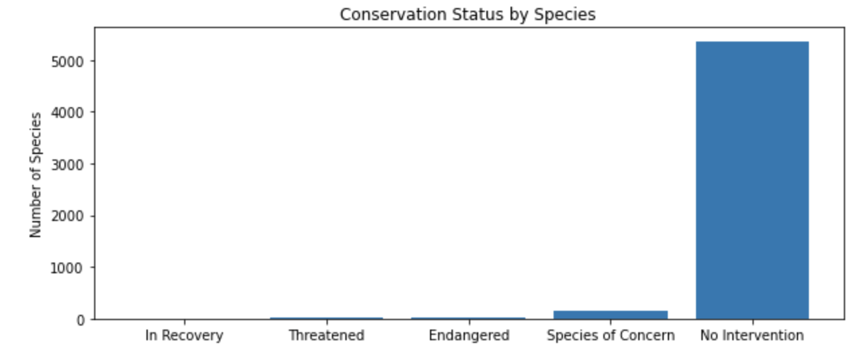
3.2 Plotting the Analysis
As the second table displayed on the prior slide, the largest segment is by far the “No Intervention” Category. However, when removed from the analysis, “Species of Concern” accounts for 83.3% of all instances within the “species” DataFrame. This would suggest there is a real need to carry out conservation work in order to slow down the declining populations of each respective species. By carrying out the conservation work at this stage on the “Species of Concern”, we could minimise the risk of these species moving into either the “Threatened” or “Endangered” categories. Once in either of the two categories, it would be more challenging to bring back into a state of “In Recovery” or to apply conservation work whilst endangered or threatened.
It would also suggest that as 5,363 species aren’t marked as needing some sort of protection, the overwhelming majority aren’t of endangerment concern, threatened or in recovery.
# Python code used to plot the bar chart.
plt.figure(figsize=(10, 4))
ax = plt.subplot() plt.bar(range(len(protection_counts)), protection_counts.scientific_name.values) ax.set_xticks(range(len(protection_counts))) ax.set_xticklabels(protection_counts.conservation_status.values)
plt.ylabel("Number of Species")
plt.title("Conservation Status by Species")
plt.show()

Slide 13
3.3 Are certain types of Species more likely to be Endangered?
Below is the summary table created using “groupby” and “pivot” from the Pandas module which displays the categories included in our “species_info.csv” dataset. Integer (INT64) fields are included for the number of Protected/Not Protected species for each Category as well as a Percent Protected (%). This puts a proportional aspect on each of the Categories and whether we believe the number of protected species is significant compared to other categories.
Category ID | Category | Not Protected | Protected | Percent Protected (%)
0 | Amphibian | 73 | 7 | 8.8%
1 | Bird | 442 | 79 | 15.2%
2 | Fish | 116 | 11 | 8.7%
3 | Mammal | 176 | 38 | 17.8%
4 | Nonvascular Plant | 328 | 5 | 1.5%
5 | Reptile | 74 | 5 | 6.3%
6 | Vascular Plant | 4424 | 46 | 1.0%
Conservation Status

Slide 14
3.3 Are certain types of Species more likely to be Endangered?
From the exhibit on the previous page (tab no. 13), we can infer from the summary table that the Category “Mammals” are less likely to be protected than “Birds” however the total population of birds tracked is greater than mammals. Plant species are also the least likely to be protected compared to animal species with Nonvascular and Vascular Plant species recording protected percentages of 1.0% and 1.5% respectively.
It’s important however to prove this hypothesis by carrying out a significance test to see if this is true. As the data being analysed falls intoa numerical category spanning multiple pieces of data, the significant test chosen was a Chi-Squared Test. In order to perform this, I carried out the creation of a Contingency table.
Conservation Status
In order to perform the chi square test, I have imported the correct function from the SciPy module:
In this scenario, we are only interested in returning the Chi2 value from the contingency test which is represented in the Output to the left:
# Importing chi2_contingency from the SciPy Module:
From scipy.stats import chi2_contingency
# Running the Chi2_contingency:
chi2, p, dof, expected = chi2_contingency(contingency_table)
Output: 0.445901703047197

Slide 15
3.4 Chi-Squared Tests
The Contingency table created takes the format below based on Mammal and Bird Categories. The P-Value definition used in these tests was 0.05, it’s important to note this was defined before carrying out any significance tests:
 | Protected | Not Protected
Mammal | 38 | 176
Bird | 79 | 442
Conservation Status
The Contingency test provides a P-Value of 0.44 which we can infer a non-significant difference between the two variables, in this case the two categories; Mammals and Birds.
 | Protected | Not Protected
Reptile | 5 | 74
Mammal | 38 | 176
The Contingency test provides a P-Value of 0.02 which we can infer a significant difference between the two variables, in this case the two categories; Reptiles and Mammals.

Slide 16
4. Recommendations around Endangered Species

Slide 17
4.1 Recommendations for Conservationists
Endangered species appear to have the lowest populations (measured by the number observations); special focus should be given to their conservation. Reptiles should have additional priority around conservation efforts. The analysis shows 6.3% of the total reptile population observed in US national parks are protected (5 to 74 respectively). The significance test carried out shows we can infer a level of significance between Reptiles and Mammals for the above hypothesis.
Birds, Mammals, Amphibians and Fish seem to be consistently be amongst the most endangered and threatened in relation to all the Categories. Future studies could be conducted to see what external factors are impacting them and how, if these can be mitigated. Additional analysis could be used to back-up this hypothesis by carrying out Chi-Squared Tests on Category and National Park in line with current analysis between two categories.
For future research, there appears to be a strong correlation between observation sizes and endangered status. An initial hypothesis could be based on the data that “if the number of observations for a species drops, this could be a strong warning that species might be under stress”. Further analysis could be carried out to see the Pearson correlation number between -1 and + 1 to determine the level of correlation between these two features and whether the relationship experienced is linear. This research if proven valid could enable more targeted and focused planning of conservation efforts and to begin these efforts at an earlier stage in the conservation lifecycle of species.
Conservation Status

